Slide 1

QER - 5535
QER: BID 141KM SF300065C004.11X - Zeta wires unlocking

Slide 2
Pipe section / Details
Item | Traceability / identification
Project number | SF300065C004
Project name | BID 141KM
Pipe section | SF300065C004.11X
ST number | ST101.51896
Affected layer / equipment | Spiralling
Length affected | 5235.3m till 5235.4m
Drawing number / MP code / STA / Dimension | Zeta wire 6.2 (MP205)

Slide 3
Overview of anomaly
Problem Description :-
During the zeta spiraling of BID 141KM SF300065C004.11X (ST101.51896), zeta wire unlocked was detected at two location on the pipe.
Details affected length as below:-
1) 5235.3m till 5235.4m
2) 5263m till 5263.1m
Root Cause :-
The root cause is to be investigated.
Problem handling :-
Reparation by un-spiral has been performed to re-position the wires to be in a good spiral. Thus, this reparation was accepted as it is and the dimensional after the repair is within the criteria.

Slide 4
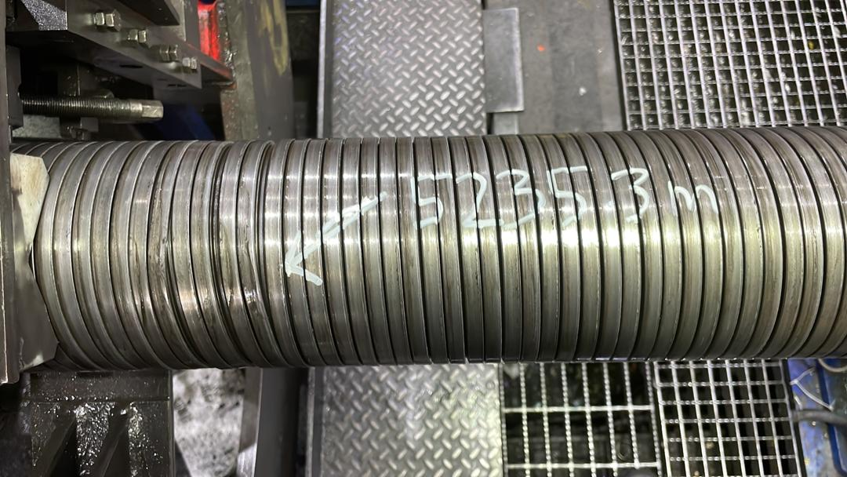
Zeta wire unlocked at length 5235.3m till 5235.4m
End defect at length 5235.4m
Start defect at length 5235.3m
Figure 1 : Zeta wire unlocked was detected at length 5235.3m till 5235.4m.

Slide 5
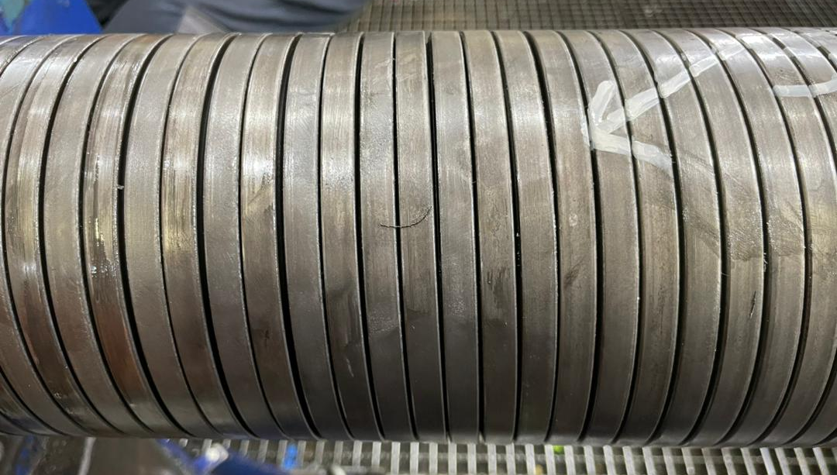
Photo after repaired
Figure 2 : Reparation by un-spiral has been performed to re-position the wires to be in a good spiral. Thus, this reparation was accepted as it is and the dimensional after the repair is within the criteria.

Slide 6
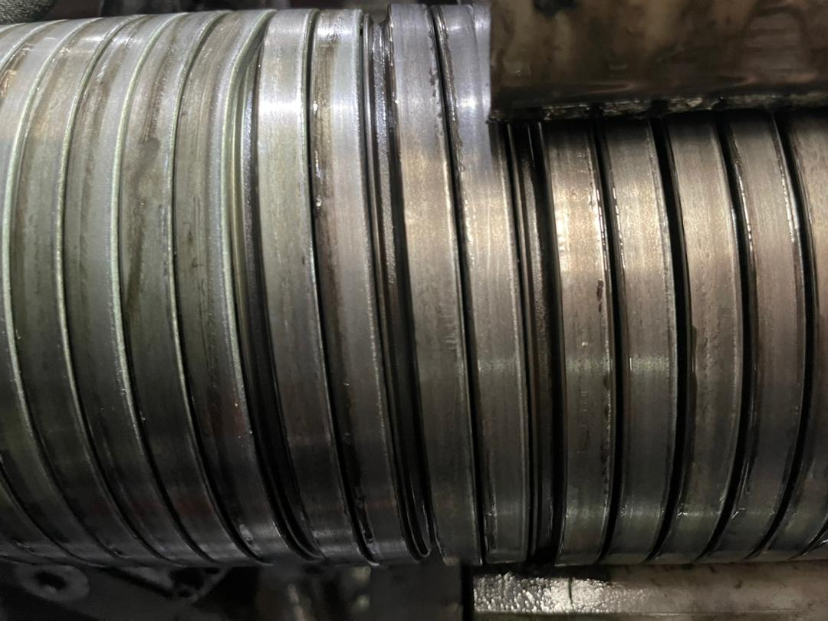
Zeta wire unlocked at length 5263m till 5263.1m
End defect at length 5263m
Start defect at length 5263.1m
Figure 3 : Zeta wire unlocked was detected at length 5263m till 5263.1m.

Slide 7
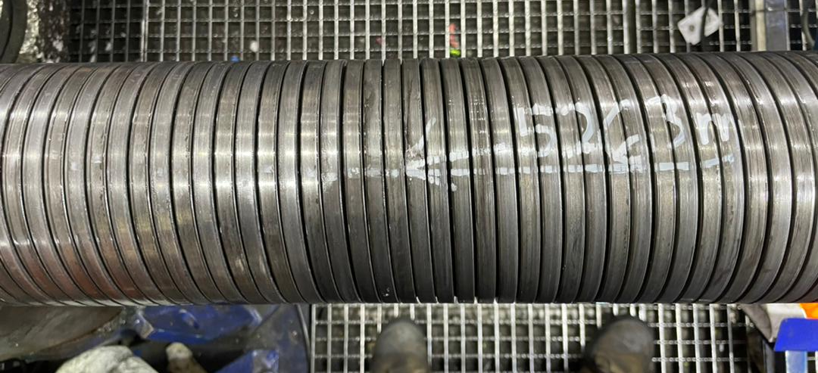
Photo after repaired
Figure 4 : Reparation by un-spiral has been performed to re-position the wires to be in a good spiral. Thus, this reparation was accepted as it is and the dimensional after the repair is within the criteria.

Slide 8

THANK YOU

